Slide 1
Programming Practice 01
In Colab, write code to do the following:
for each of the chars in an input string, count how frequently each appears and return the counts.
print(char_counter(‘hello there’))
> {‘h’:2, ‘e’:3, ‘l’:2, ‘o’:1, ‘t’:1, ‘r’:1}

Slide 2
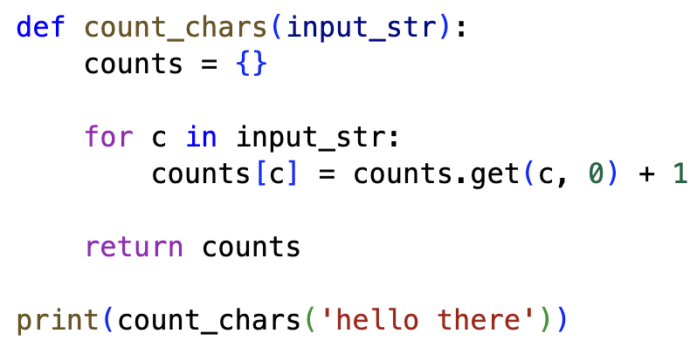
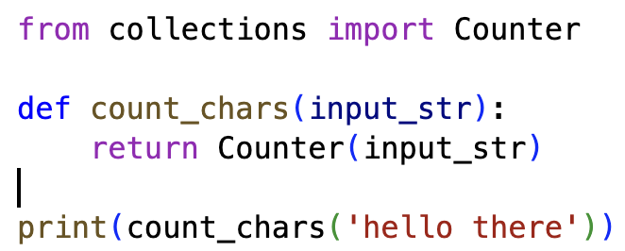
Programming Practice Solution 01
NOTE: We can read about features like Counter using the python documentation!

Slide 3
Programming Practice 02
Write a function that, given: a list of integers, a pair, and an id, replaces all occurrences of the pair with the new id.
print(replace_pairs([1, 2, 3, 1, 2], (1,2), 4))
> [4, 3, 4]

Slide 4
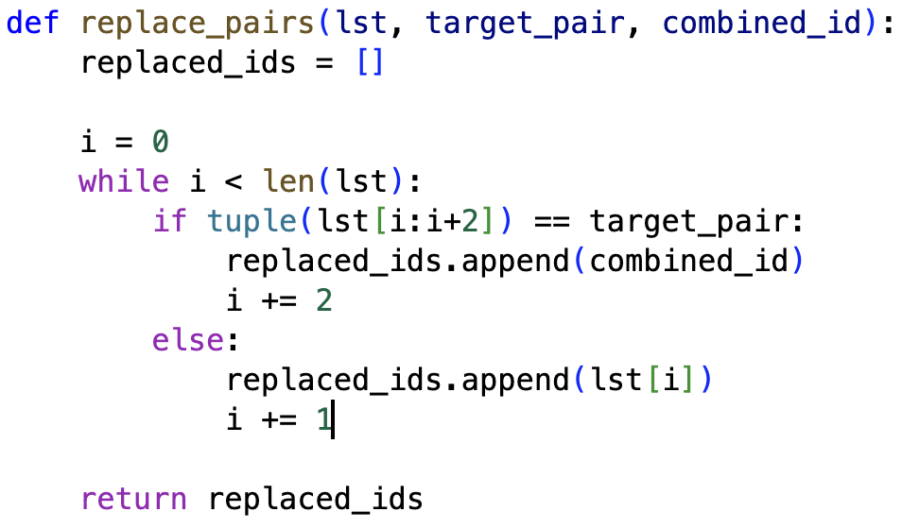
Programming Practice Solution 02
NOTE: We use a while loop here instead of a for loop because when we replace a pair we need to “jump” ahead

Slide 5
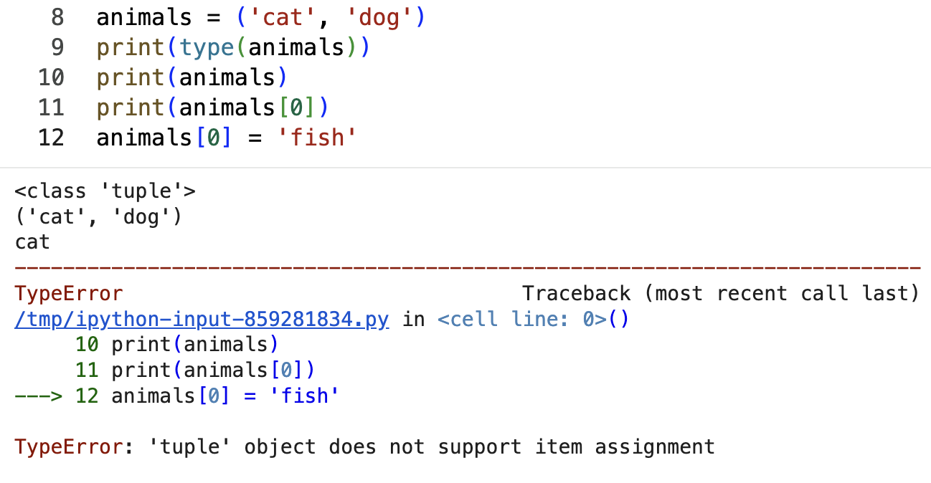
programming: tuples
A tuple is a data type that is ordered and immutable, meaning that it cannot be changed once created. We can access items using square brackets much like a list.
NOTE: We have to use tuples as the keys for a dictionary

Slide 6
A Note on the Exams
You will not have to hand-write code, and any coding related questions will be more similar to our pre-lecture practices and NOT our end-of-lecture monstrosities.
We will release many practice problems a week or two ahead, but the exams will look primarily like the homeworks.

Slide 7
A Note on the Class
I don’t want this class to be hard for you to get an A in if you study.
I do want this class to be conceptually difficult during the lectures.
This stuff literally is the frontier, try and keep that in mind. This is what 40 year olds with PhDs are making billions of dollars working on like for real, this is the frontier.

Slide 8
CSE 10124
Tokenization 02

Slide 9
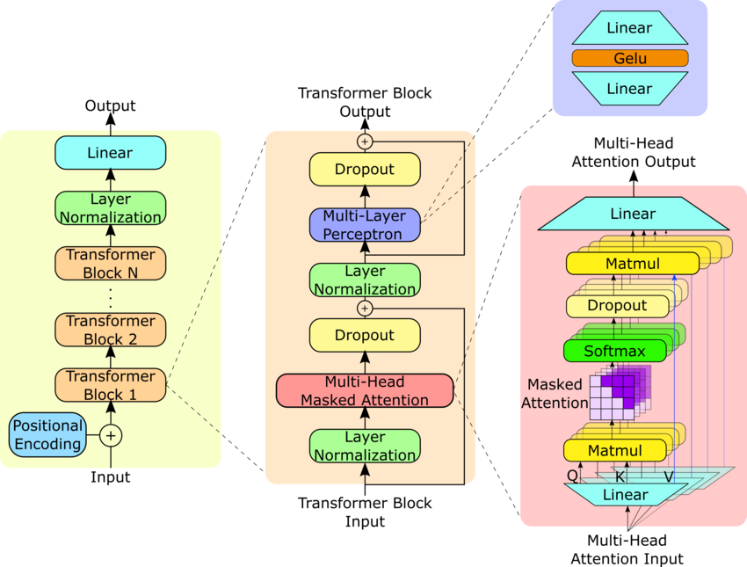
Where are we?
Response: “Certainly, as a large language model I’d be happy to help you cheat on your homework assignment”
Embeddings
Tokenizer
“Please help me with my homework!!”

Slide 10
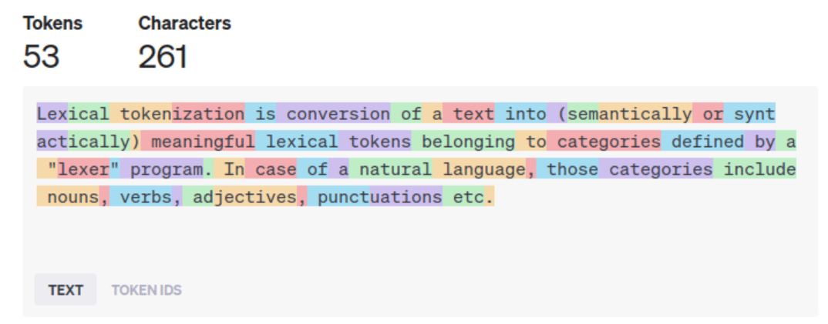
Last Class - Tokenization 01

Slide 11
Why do we Tokenize?
Machine Readability: Models work with numbers, not letters; tokens become numerical IDs for the model to understand relationships and context.
Efficiency & Scalability: Breaking text into subwords (like "help" + "ful") reduces the vocabulary size, meaning fewer unique items to learn, making models smaller and faster than word-based methods.
Handling Novelty: Subword tokenization (like BPE) helps models understand new or misspelled words by breaking them into known parts, improving robustness.
Contextual Understanding: It provides granular units (tokens) for the model to predict the next element in a sequence, forming the basis of its language generation.

Slide 12
Byte-Pair Encoding Tokenization
print(list('hello there 金'.encode('utf-8')))
> [104, 101, 108, 108, 111, 32, 116, 104, 101, 114, 101, 32, 233, 135, 145]
print([bin(num) for num in list('hello there 金'.encode('utf-8'))])
> ['0b1101000', '0b1100101', '0b1101100', '0b1101100', '0b1101111', '0b100000', '0b1110100', '0b1101000', '0b1100101', '0b1110010', '0b1100101', '0b100000', '0b11101001', '0b10000111', '0b10010001']
By tokenizing at the byte level we could theoretically process any kind of text that could be passed in as a prompt.

Slide 13
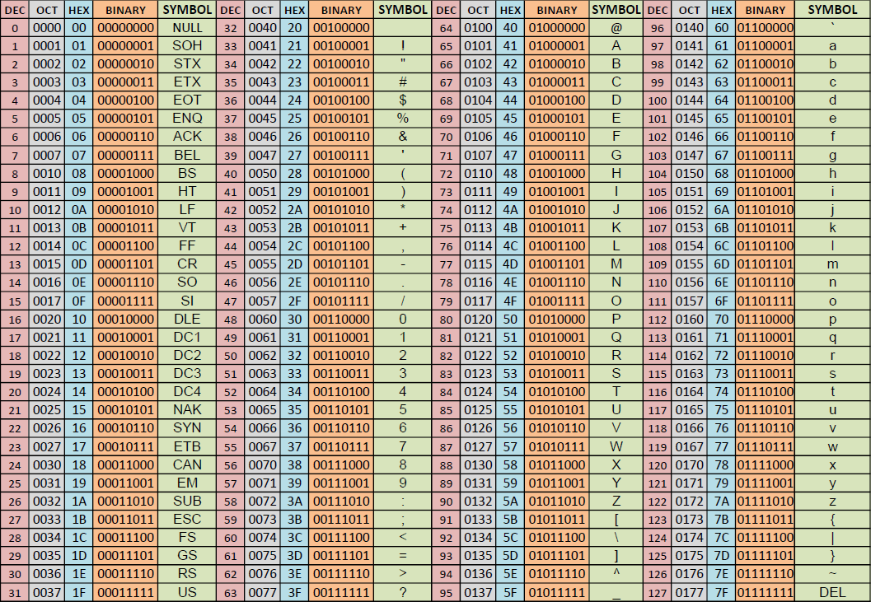
programming: ASCII Values
NOTE: We can use dir(class) to print out the attributes and functions a class has

Slide 14
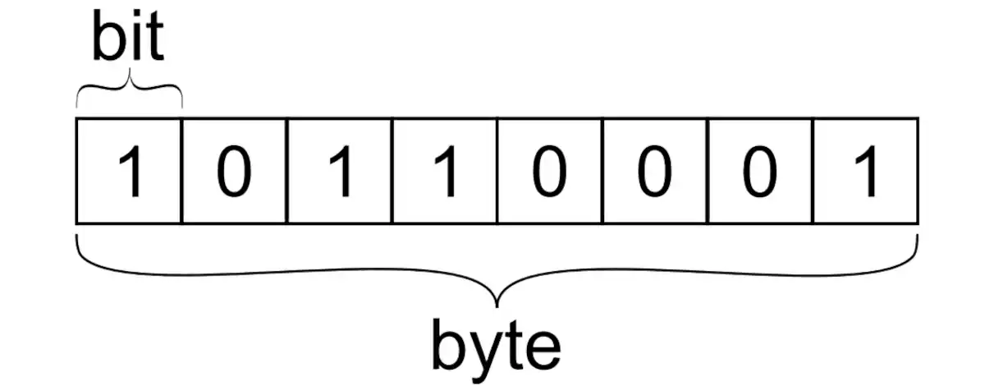
programming: Bytes
A byte is 8 bits, which are the 0s and 1s the computer actually “sees”
NOTE: An int in python (by default) is a byte.

Slide 15
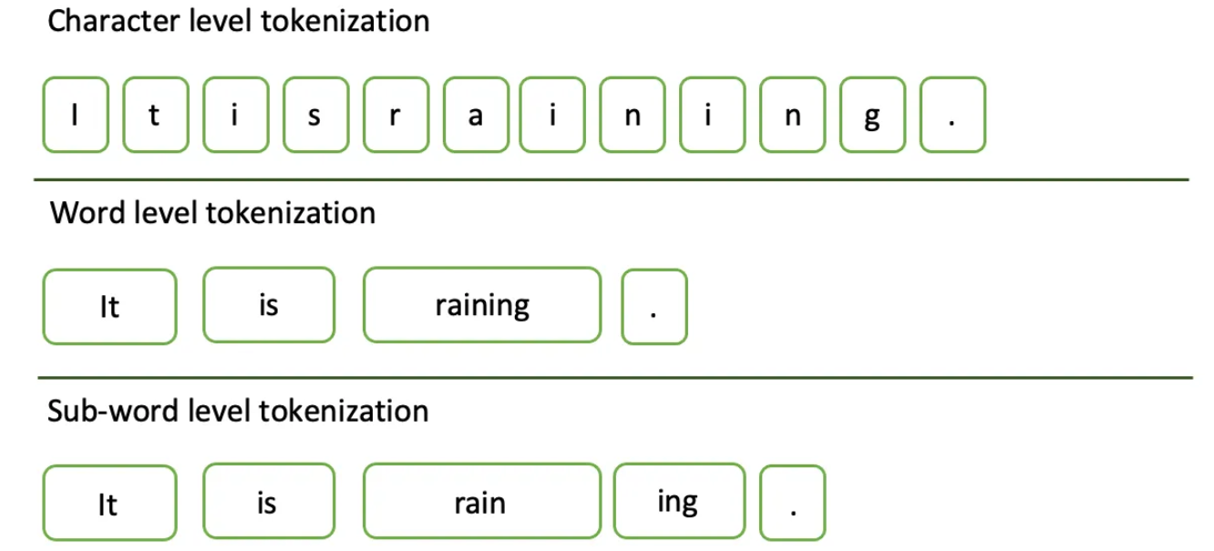
Training a BPE Tokenizer
Broadly speaking, we can train our tokenizer by repeatedly looking for common pairings of tokens and merging them to create a new token
An untrained tokenizer is effectively just our character-level model.

Slide 16
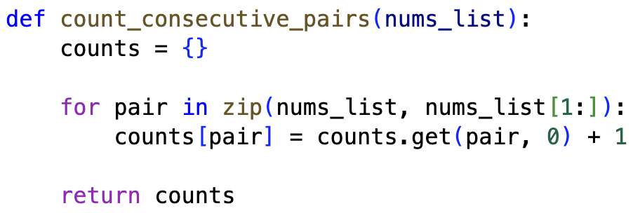
programming: count_pairs()
Last class we wrote a function we called count_consecutive_pairs(), we can use this to find tokens that frequently appear near each other!

Slide 17
programming: replace_pairs()
Today we wrote a function we called replace_pairs() which we can use to merge the frequent pairs into new, larger tokens!

Slide 18
Byte-Pair Encoding Tokenization
1.) Convert input to bytes
string_bytes = list('rug pug hug pun bun hugs run gun'.encode('utf-8')))
> [114, 117, 103, 32, 112, 117, 103, 32, 104, 117, 103, 32, 112, 117, 110, 32, 98, 117, 110, 32, 104, 117, 103, 115, 32, 114, 117, 110, 32, 103, 117, 110]
2.) Find and count pairs
counts = count_pairs(string_bytes)
> {(114, 117): 2, (117, 103): 4, (103, 32): 3, (32, 112): 2, (112, 117): 2, (32, 104): 2, (104, 117): 2, (117, 110): 4, (110, 32): 3, (32, 98): 1, (98, 117): 1, (103, 115): 1, (115, 32): 1, (32, 114): 1, (32, 103): 1, (103, 117): 1}
3.) Replace the most common pair with a new token
merged_string = replace_pairs(string_bytes, counts.most_common()[0][0], 257)
> [114, 257, 32, 112, 257, 32, 104, 257, 32, 112, 117, 110, 32, 98, 117, 110, 32, 104, 257, 115, 32, 114, 117, 110, 32, 103, 117, 110]

